Slide 1
Postgraduates who Tutor in Mathematics Support Centres
Workshop

Slide 2
Initial Activity
On your own, write down:
One item that you want to learn or get from today
At least one question that you would like answered by the end of this session

Slide 3
Mathematics support – what is it ?
What do you think it is ? What does this term mean to you ?

Slide 4
Mathematics support – what is it ? [some suggested responses; these will vary from institution to institution]
activities and/or resources provided to support and enhance students’ learning of mathematics or statistics
in any subject, at any level of higher education,
and which are provided separately and in addition to traditional lectures, tutorials, examples classes, personal tutorial sessions.

Slide 5
A mathematics support centre – what is it ?
What is a support centre ?
What does your centre look like ?
How does your centre operate ?

Slide 6
A mathematics support centre – what is it ? [some suggested responses; these will vary from institution to institution]
Dedicated (real) space in which to offer support
Tutors available at specified times
May contain a bank of resources
May include student workspace
May include access to computing and other facilities (e.g. video)
May be located in a department or in a central service (e.g. library skills centre)
May have dedicated staffing
May be the focus of related initiatives

Slide 7
Support provided in different ways
Drop-in – tutors and/or postgraduates available for 1-1 help
Appointment based
Web-based (virtual classroom)
Located in a maths (or other) department
Located in a central study support facility
Located in a Library
Just for first years, just for engineers,
Open to anyone at any level
Maths Café, Maths Arcade

Slide 8
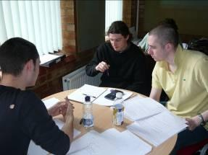
A mathematics support centre – what is it ?
Maths support at Loughborough
MASH at Sheffield

Slide 9
Mathematics support – Why is it needed now ?

Slide 10
Mathematics support – Why is it needed ? [some suggested responses; these will vary from institution to institution]
In the UK maths support began to take off in the 1990s in response to many students struggling with mathematics at university
Failure, withdrawal, disappointment, dissatisfaction
Increasingly quantitative nature of many disciplines – e.g. biosciences, social sciences
Many many reports draw attention to a serious maths problem in the UK.

Slide 11
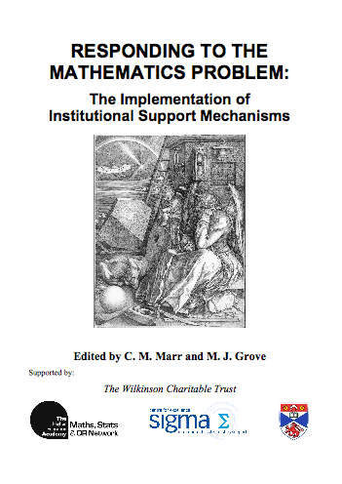
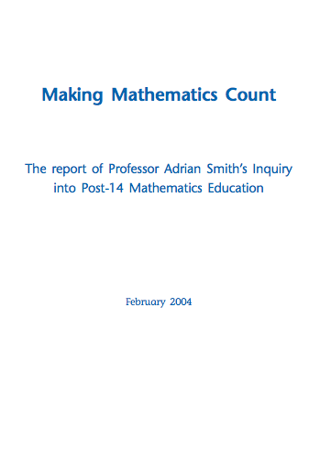
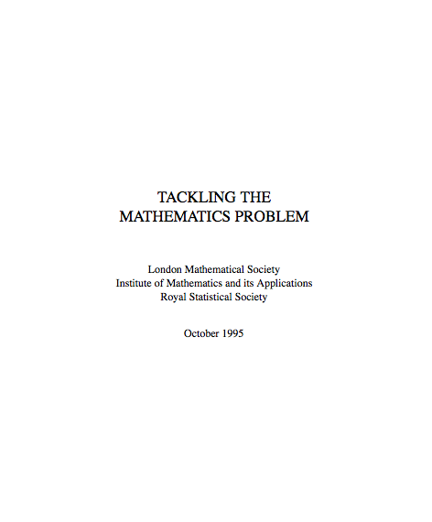
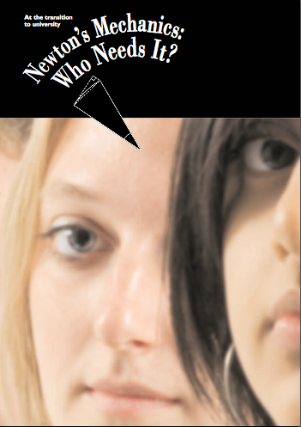
The “mathematics problem” – a plethora of reports

Slide 12
The “mathematics problem” – a plethora of reports
higher education has little option but to accommodate to the students emerging from the current GCE [ie pre-university schooling] process. Prof. Sir Adrian Smith, 2004,
Making Mathematics Count: Section 4.39
Notes:
“There is unprecedented concern amongst mathematicians, scientists and engineers in higher education about the mathematical preparedness of new undergraduates. ” LMS, IMA, RSS, 1995, Tackling the Mathematics Problem.

Slide 13
The “mathematics problem”– a plethora of reports
Acute problems now confront those teaching mathematics and mathematics-based modules across the full range of universities…..
Prompt and effective support should be available to students whose mathematical background is found wanting….. Measuring the mathematics problem.
Engineering Council (2000)
Notes:
“There is unprecedented concern amongst mathematicians, scientists and engineers in higher education about the mathematical preparedness of new undergraduates. ” LMS, IMA, RSS, 1995, Tackling the Mathematics Problem.

Slide 14
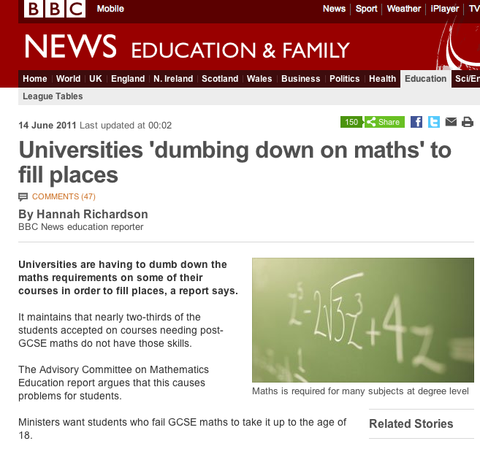
ACME report 2011
ACME – Advisory Committee on Mathematics Education – June 2011
We estimate that of those entering higher education in any year, some 330,000 would benefit from recent experience of studying some mathematics (including statistics) at a level beyond GCSE.
At the moment fewer than 125,000 have done so.
Over 60% of students entering higher education courses which require good mathematical skills beyond GCSE level have not benefitted from higher level study
Notes:
ACME, based at the Royal Society, aims to influence strategy and policy with a view to improve mathematics teaching and learning in England.
ACME have just recently published two reports on the mathematics needed in the workplace and in higher education, and the mathematical needs of learners.
Some of their findings are quite stark – let me share just one with you.
Over 60% of students entering higher education courses which require good mathematical skills beyond GCSE level have not benefitted from higher level study - these students are to be found in universities through England in departments such as Chemistry, Economics, Engineering, Design and Technology…
This is in stark contrast to many other countries; Germany for example requires all its students to study mathematics until age 18.

Slide 15
Is the UK an outlier in upper secondary maths education ?
Nuffield Foundation Report (2010)
In a survey of 24 countries, England, Wales and Northern Ireland had the lowest levels of participation in upper secondary mathematics.
They were the only countries in which fewer than 20% of upper secondary students study maths. This includes all mathematics qualifications at this level.
England, Scotland, Wales and Northern Ireland are four of only six countries that do not require compulsory participation in mathematics at upper secondary for any students.
Notes:
ACME, based at the Royal Society, aims to influence strategy and policy with a view to improve mathematics teaching and learning in England.
ACME have just recently published two reports on the mathematics needed in the workplace and in higher education, and the mathematical needs of learners.
Some of their findings are quite stark – let me share just one with you.
Over 60% of students entering higher education courses which require good mathematical skills beyond GCSE level have not benefitted from higher level study - these students are to be found in universities through England in departments such as Chemistry, Economics, Engineering, Design and Technology…
This is in stark contrast to many other countries; Germany for example requires all its students to study mathematics until age 18.

Slide 16
Current thinking:
maths support – support for all – not just the struggling student, not just remedial
enhancement model
valuable contribution to improving employability of graduates
League tables, competition, NSS and student satisfaction

Slide 17
Why is tutoring in a support centre different from module tutoring ?

Slide 18
Why is tutoring in a support centre different from module tutoring ? [some suggested responses; these will vary from institution to institution]
Don’t necessarily know who the students are, nor which departments they have come from.
Don’t necessarily know what they should have been taught, what they should have already learned.
Students may be from departments which are not traditionally taught mathematics (e.g. geography, business studies) and may be very alienated, intimidated, nervous….
Students may not want to discuss their problems with staff who teach them
They may be poorly-prepared for what is expected of them
More difficult to prepare

